Slide 1
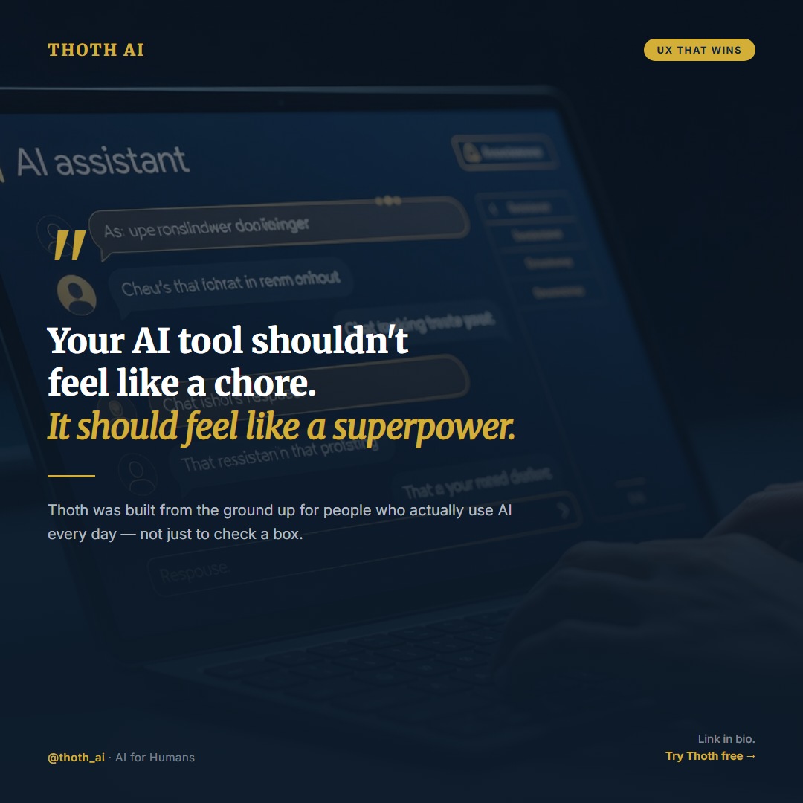
THOTH AI
UX THAT WINS
"
Your AI tool shouldn't feel like a chore. It should feel like a superpower.
Thoth was built from the ground up for people who actually use AI every day — not just to check a box.
Link in bio. Try Thoth free →
@thoth_ai · AI for Humans

Slide 2
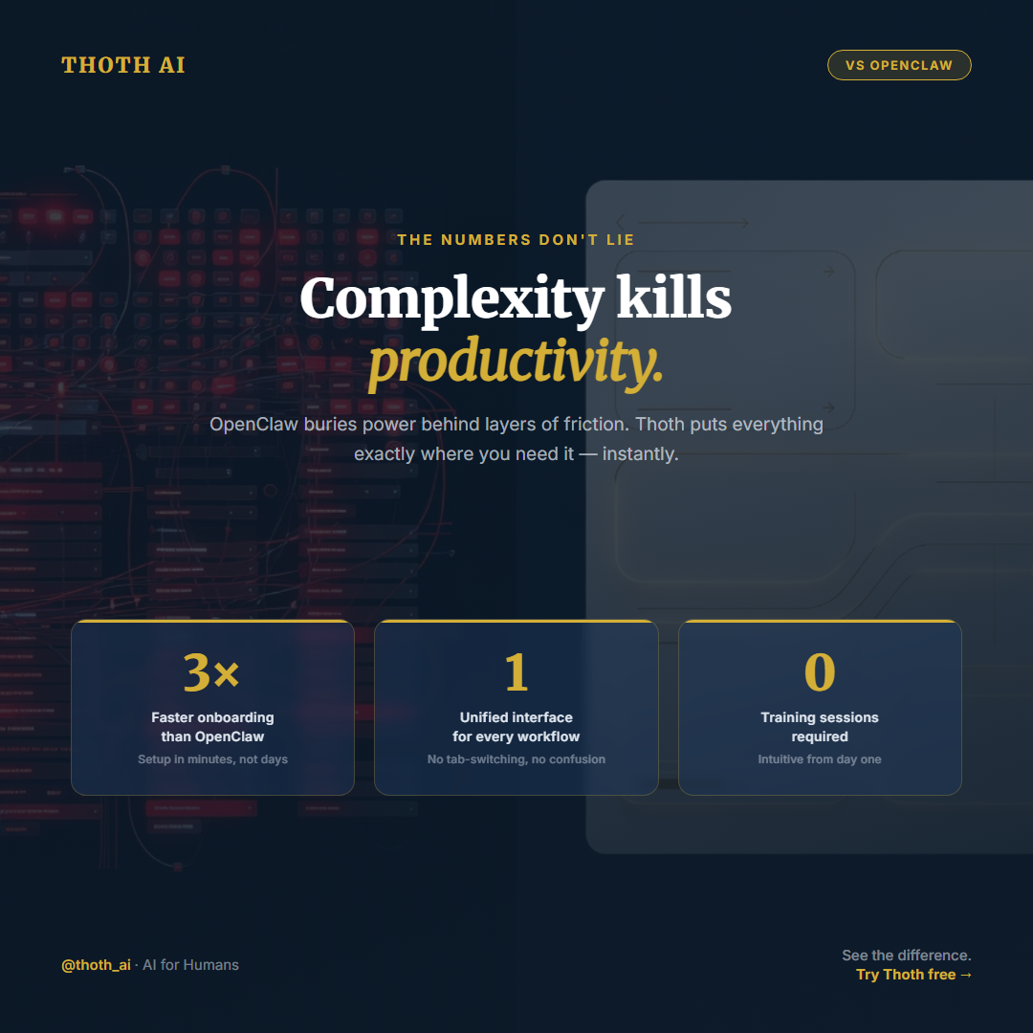
THOTH AI
VS OPENCLAW
THE NUMBERS DON'T LIE
Complexity kills productivity.
OpenClaw buries power behind layers of friction. Thoth puts everything exactly where you need it — instantly.
3×
1
0
Faster onboarding than OpenClaw
Unified interface for every workflow
Training sessions required
Setup in minutes, not days
No tab-switching, no confusion
Intuitive from day one
@thoth_ai · AI for Humans
See the difference. Try Thoth free →

Slide 3
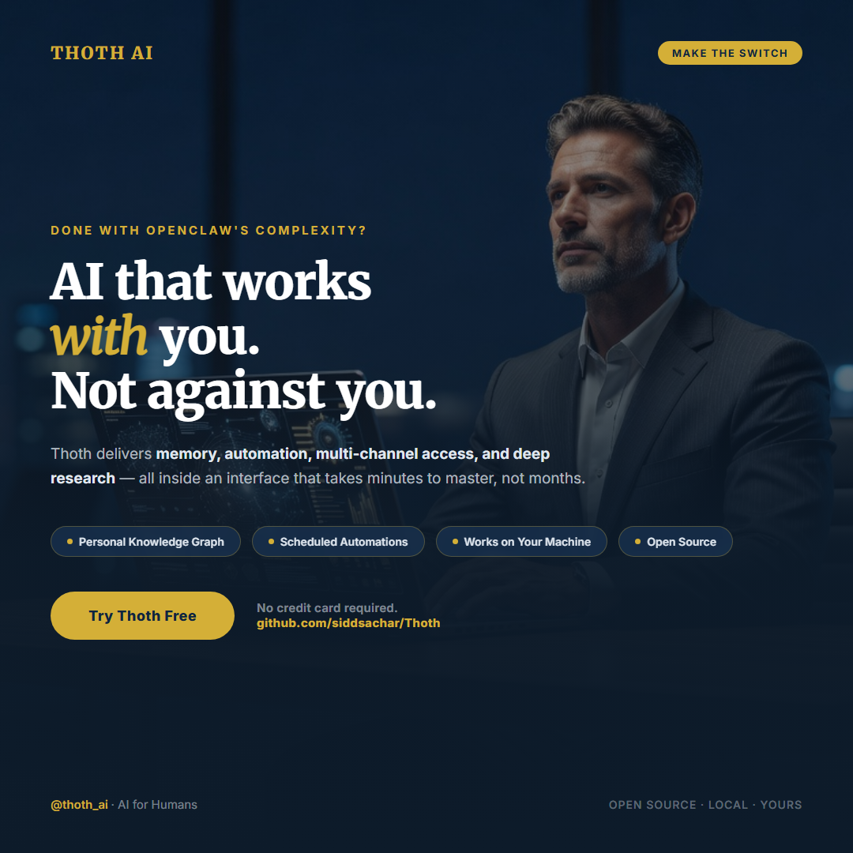
THOTH AI
MAKE THE SWITCH
DONE WITH OPENCLAW'S COMPLEXITY?
AI that works with you. Not against you.
Thoth delivers memory, automation, multi-channel access, and deep research — all inside an interface that takes minutes to master, not months.
Personal Knowledge Graph
Scheduled Automations
Works on Your Machine
Open Source
Try Thoth Free
No credit card required. github.com/siddsachar/Thoth
@thoth_ai · AI for Humans
OPEN SOURCE · LOCAL · YOURS

